Slide 1
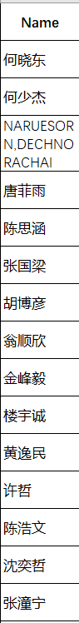
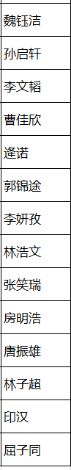

Welcome! A2のTA: Yu Jiarui Please sit in groups of 4-5 people

Slide 2
ABOUT ME
CE2002 Jiarui Yu 虞佳睿
Jiarui.20@intl.zju.edu.cn
A in MATH 221, TA of FA21 MATH 221
A in MATH 231
A in MATH 241
A in MATH 286

Slide 3
Why I choose to be MATH 241 TA
学的海星
I had a nice TA
ZJUI MATH 241 spirit

Slide 4
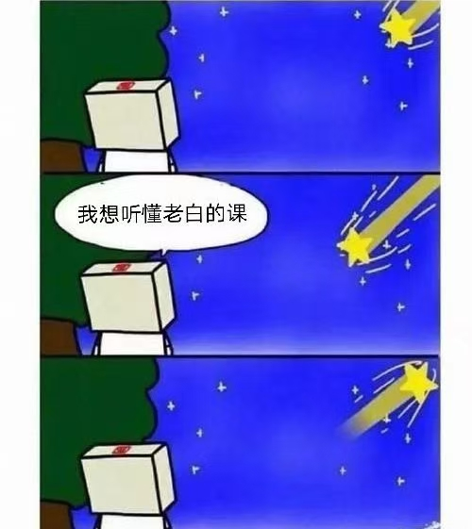
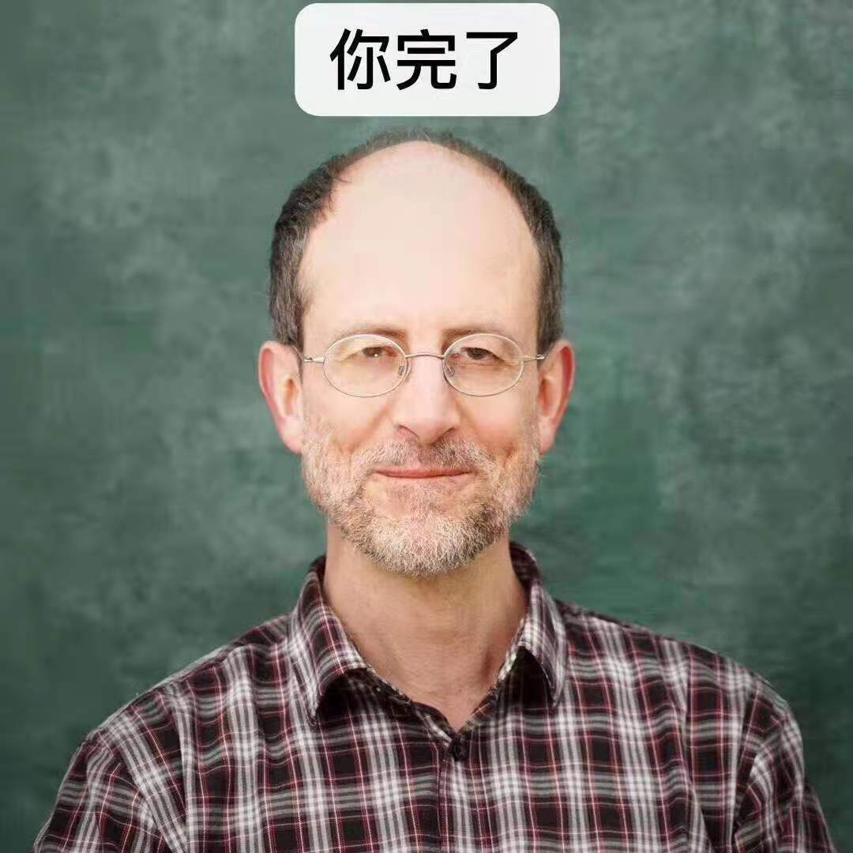
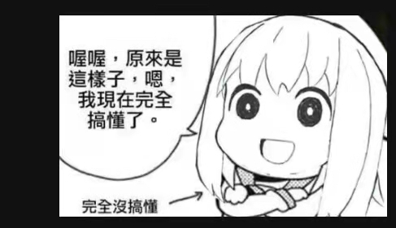
About MATH 241
Probably the toughest math course you’ve ever meet
Prof. Dr. Thomas Honold
数学博士学位 from 德国慕尼黑工业大学
ZJUI staff.
MATH 241&MATH 286 (intro to differential equations PLUS)&MATH 257

Slide 5
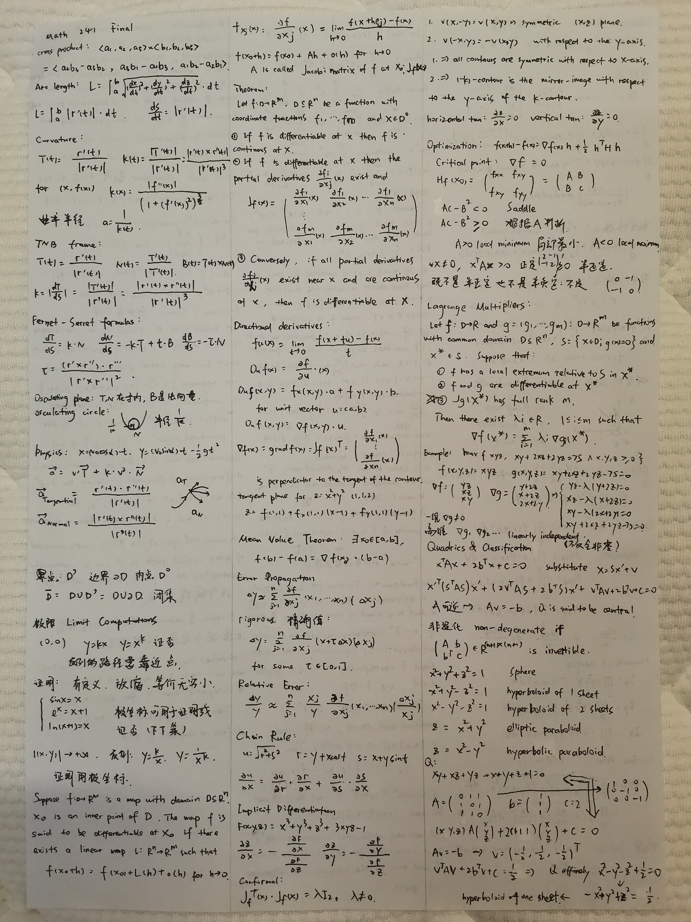
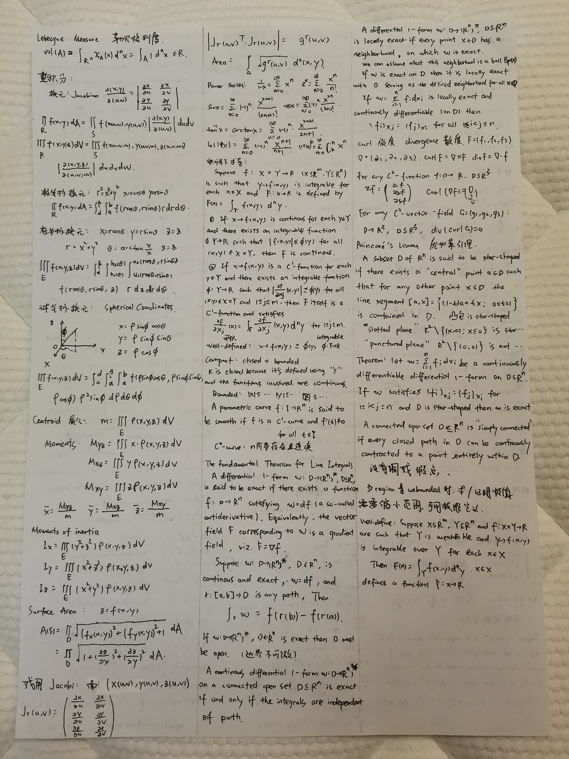

Slide 6
About discussion—help you to learn
Hand in homework by the end of the class (before I leave)
Listen to me BBing about the lecture, feel free to interrupt me if you have questions
Do the worksheet in groups
Share the solutions(or ideas) of the worksheet problems
I’m not expecting you to understand all the content of the worksheet during the discussion, so is professor. Just try the best!
You are suggested to attend all the discussion sessions. I’m actually helping you to save time for ECE 220, CEE 360 etc.

Slide 7
Policy about discussion
1 point for all work group members for an (essentially) complete
solution
1 extra point for the presenter of the solution
'n.a.' (not attending) for students who don't attend the discussion session
At the end of the semester, all points for each will be summed up and then normalized to 10 (indicated in the syllabus)
Just be brave and share!

Slide 8
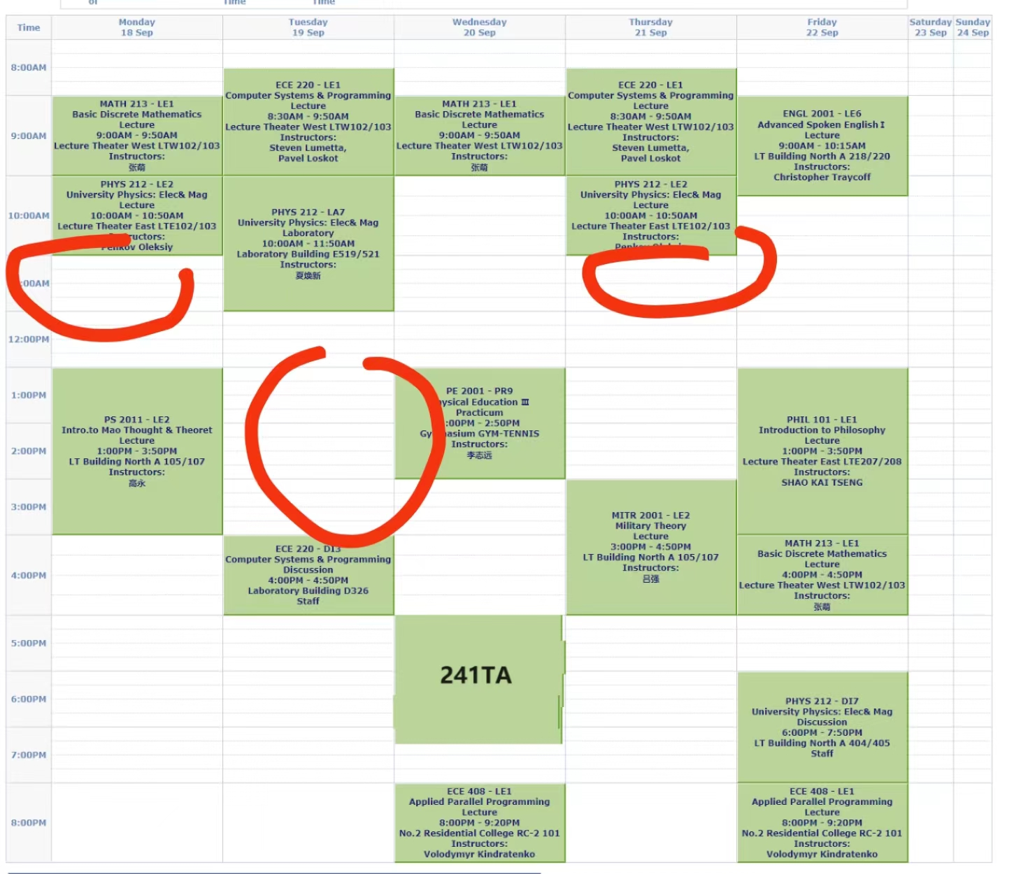
Office hour location: coffee house, 1st floor of the library Time: Tuesday 8-9 for now, if there is any change I’ll inform in WeChat group Try to bring your questions to office hour instead of asking me on WeChat

Slide 9
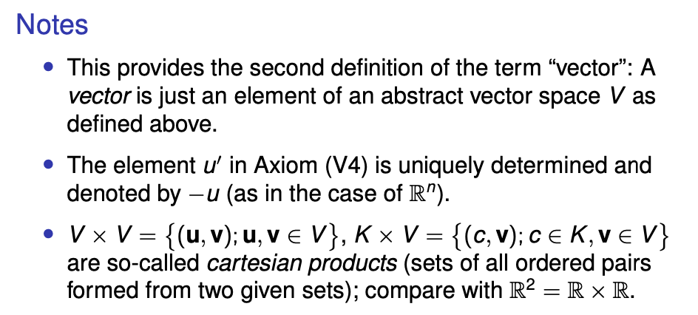
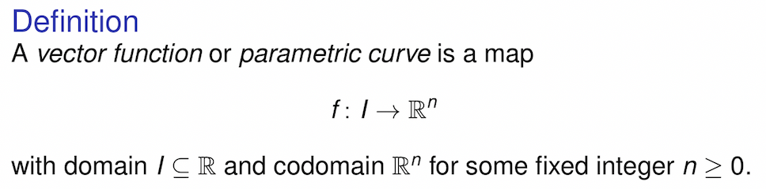

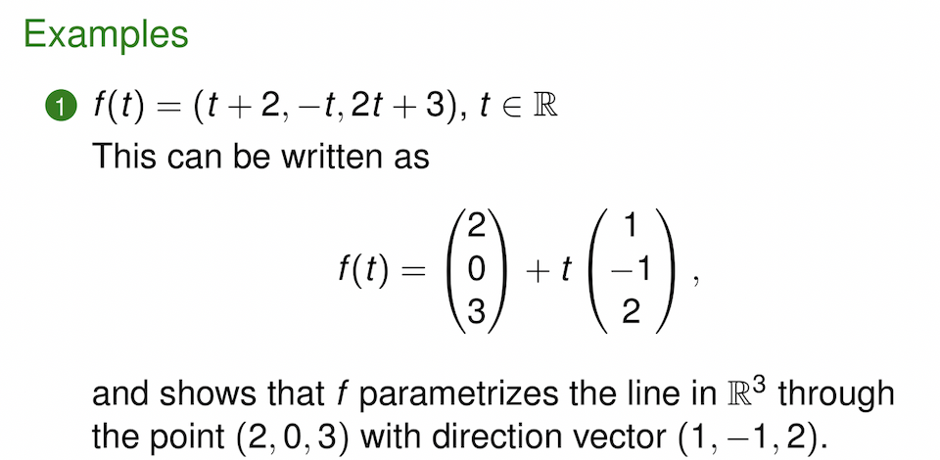
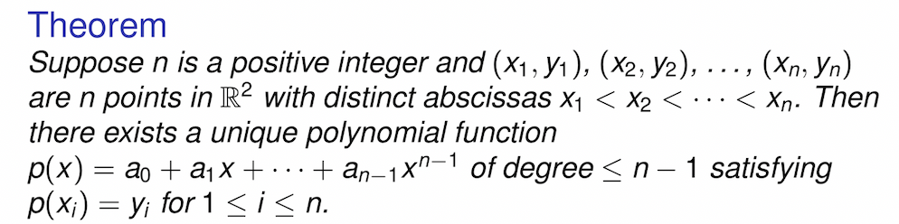
Terms of MATH 241 lectures: What’s important:

Slide 10
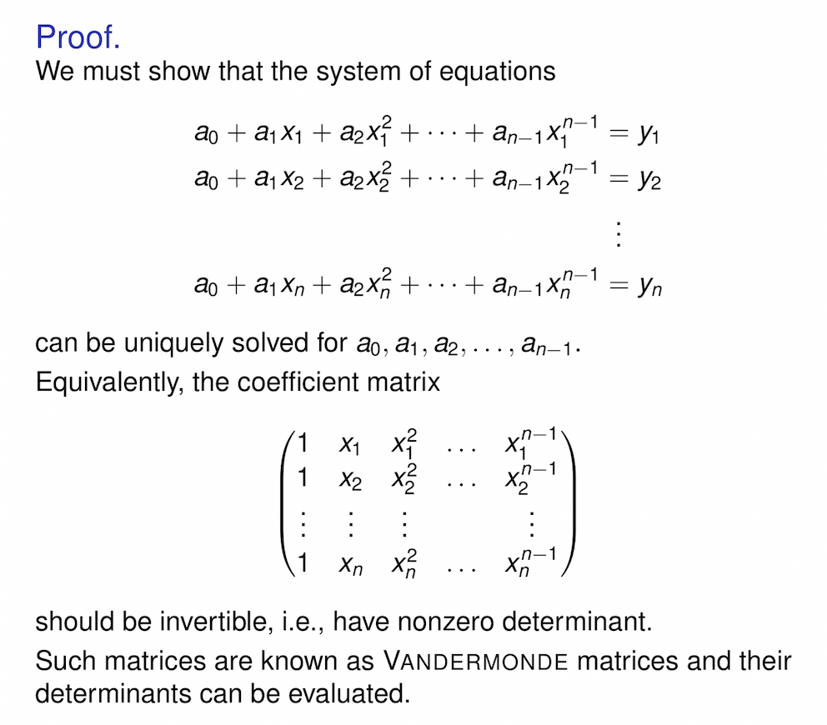
Not Sooooo important:
Actually, some are not important at all!
Especially for the looooooooooooooooooooooooooong、çômpłëx proofs. So do not be too cautious

Slide 11
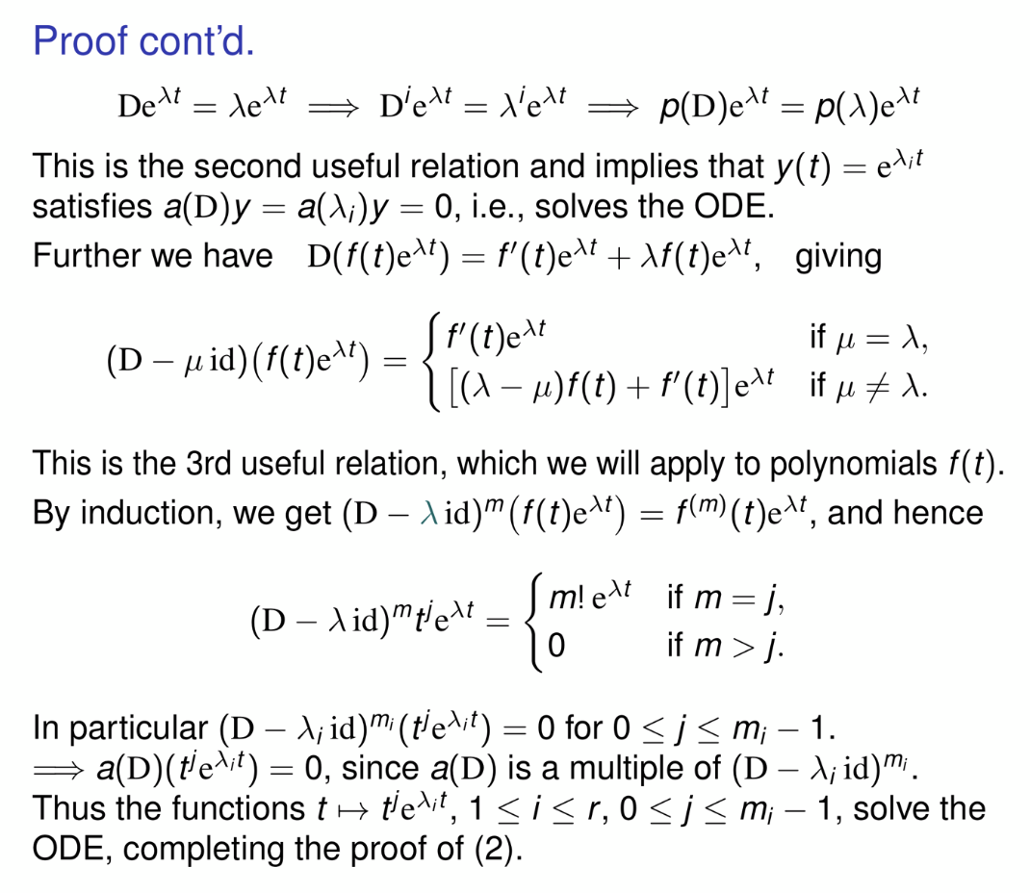
The most useful but the most useless
Time consuming!
Sometimes it’s the thing that only老白 can understand
能明白个大概就看看，看不懂就早点溜溜球
有些东西只有老白能懂

Slide 12
Acknowledgement
The content of this intro PPT is revised based on the intro PPT of Li Zihao, my 241 TA in Fall 2021

Slide 13
Start Worksheet1
Any more questions? If not……
But before, let me discuss about some background information about analytic geometry, which will be used in WS 1.

